Slide 1

Python Modules for Data Analysis
Week 3: Modules.
Prof J.W. Muteba Mwamba

Slide 2
Popular Python Libraries for Data Science
Many popular Python toolboxes/libraries:
NumPy
SciPy
Pandas
SciKit-Learn
Visualization libraries
matplotlib
Seaborn
and many more …
and many more …

Slide 3
Popular Python Libraries for Data Science
Popular Python toolboxes/libraries:
Visualization libraries
Machine Learning:
NumPy
SciPy
Pandas
SciKit-Learn
matplotlib
Seaborn
•Keras
•SciKit-Learn
•PyTorch
•TensorFlow
•XGBoost

Slide 4
NumPy: “import numpy as np”
NumPy:
introduces objects for multidimensional arrays and matrices, as well as functions that allow to easily perform advanced mathematical and statistical operations on those objects
provides vectorization of mathematical operations on arrays and matrices which significantly improves the performance
many other python libraries are built on NumPy
Link: http://www.numpy.org/

Slide 5
NumPy Overview
Arrays
Shaping and transposition
Mathematical Operations
Indexing and slicing
Broadcasting

Slide 6
Arrays
Structured lists of numbers.
Vectors
Matrices
Images
Tensors
ConvNets

Slide 7
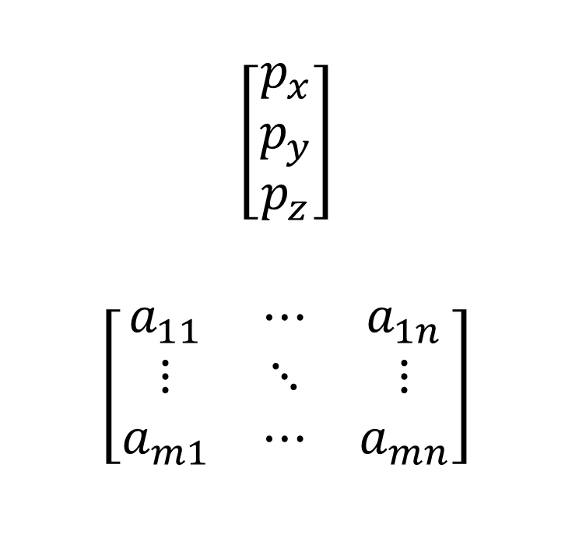
Arrays
Structured lists of numbers.
Vectors
Matrices
Images
Tensors
ConvNets
$$\left[\begin{matrix}p_{x} \\ p_{y} \\ p_{z}\end{matrix}\right]$$
$$\left[\begin{matrix}a_{11} & ⋯ & a_{1n} \\ ⋮ & ⋱ & ⋮ \\ a_{m1} & ⋯ & a_{mn}\end{matrix}\right]$$

Slide 8

Arrays
Structured lists of numbers.
Vectors
Matrices
Images
Tensors
ConvNets

Slide 9
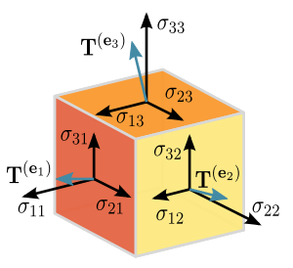
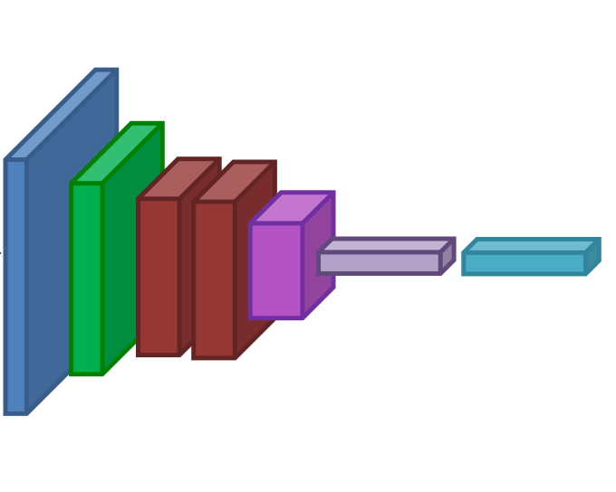
Arrays
Structured lists of numbers.
Vectors
Matrices
Images
Tensors
ConvNets

Slide 10
Numpy Arrays, Basic Properties
import numpy as np
a = np.array([[1,2,3],[4,5,6]],dtype=np.float32)
print a.ndim, a.shape, a.dtype
Arrays can have any number of dimensions, including zero (a scalar).
Arrays are typed: np.uint8, np.int64, np.float32, np.float64
Arrays are dense. Each element of the array exists and has the same type.

Slide 11
Numpy Arrays, creation
np.ones, np.zeros
np.arange
np.concatenate
np.astype
np.zeros_like, np.ones_like
np.random.random

Slide 12
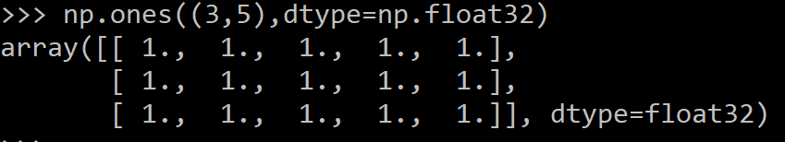
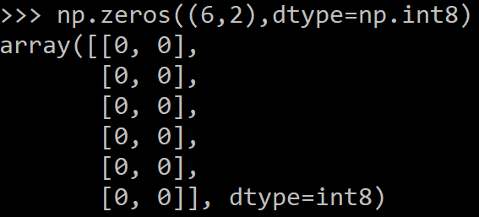
Numpy Arrays, creation
np.ones, np.zeros
np.arange
np.concatenate
np.astype
np.zeros_like, np.ones_like
np.random.random

Slide 13

Numpy Arrays, creation
np.ones, np.zeros
np.arange
np.concatenate
np.astype
np.zeros_like, np.ones_like
np.random.random

Slide 14
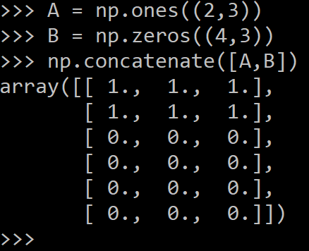
Numpy Arrays, creation
np.ones, np.zeros
np.arange
np.concatenate (on rows)
np.astype
np.zeros_like, np.ones_like
np.random.random

Slide 15
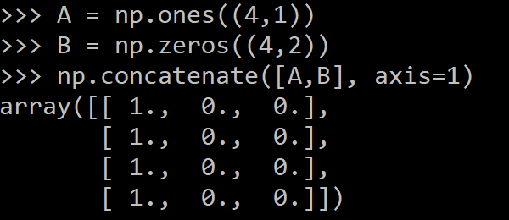
Numpy Arrays, creation
np.ones, np.zeros
np.arange
np.concatenate (on columns)
np.astype
np.zeros_like, np.ones_like
np.random.random

Slide 16
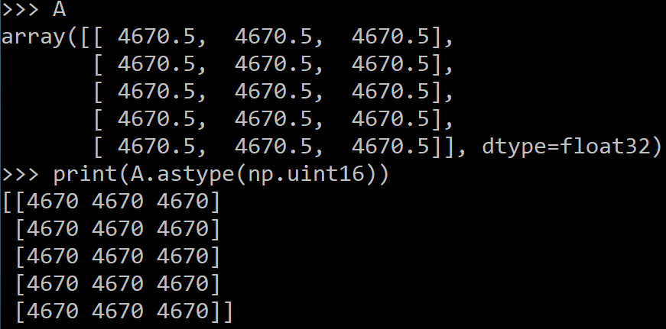
Numpy Arrays, creation
np.ones, np.zeros
np.arange
np.concatenate
np.astype
np.zeros_like, np.ones_like
np.random.random

Slide 17
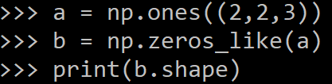
Numpy Arrays, creation
np.ones, np.zeros
np.arange
np.concatenate
np.astype
np.zeros_like, np.ones_like
np.random.random

Slide 18
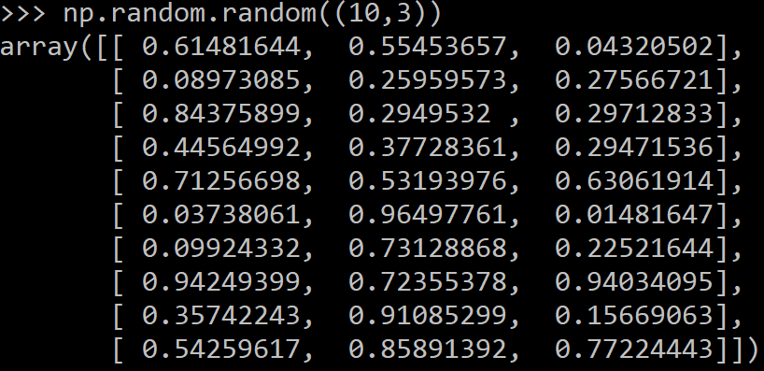
Numpy Arrays, creation
np.ones, np.zeros
np.arange
np.concatenate
np.astype
np.zeros_like, np.ones_like
np.random.random

Slide 19
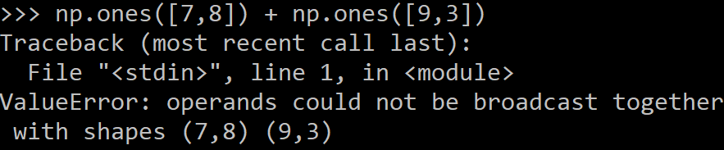
Numpy Arrays operations
Arrays must be dense, no holes.
Must be one type
Cannot combine arrays of different shape

Slide 20
Numpy Shaping
a = np.array([1,2,3,4,5,6])
a = a.reshape(3,2)
a = a.reshape(2,-1)
a = a.ravel()
Total number of elements cannot change.

Slide 21
Numpy Transposition
a = np.arange(10).reshape(5,2)
a = a.T
a = a.transpose((1,0))
np.transpose permutes axes.
a.T transposes the first two axes.

Slide 22

Numpy Image arrays
Images are 3D arrays: width, height, and channels
Common image formats:
height x width x RGB (band-interleaved)
height x width (band-sequential)

Slide 23
Saving and Loading Images
Numpy PIL / Pillow: PIL.Image.open, Image.save
width x height x RGB
…………………………………………………………………
OpenCV: cv2.imread, cv2.imwrite
height x width x BGR
………………………………………...
Example with Pillow (PIL =Python Imaging Library)

Slide 24
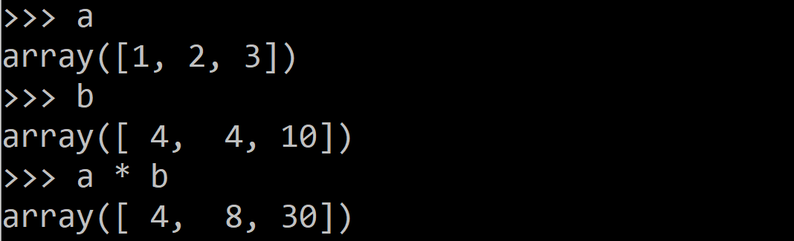
Numpy Mathematical operators
Arithmetic operations are element-wise

Slide 25
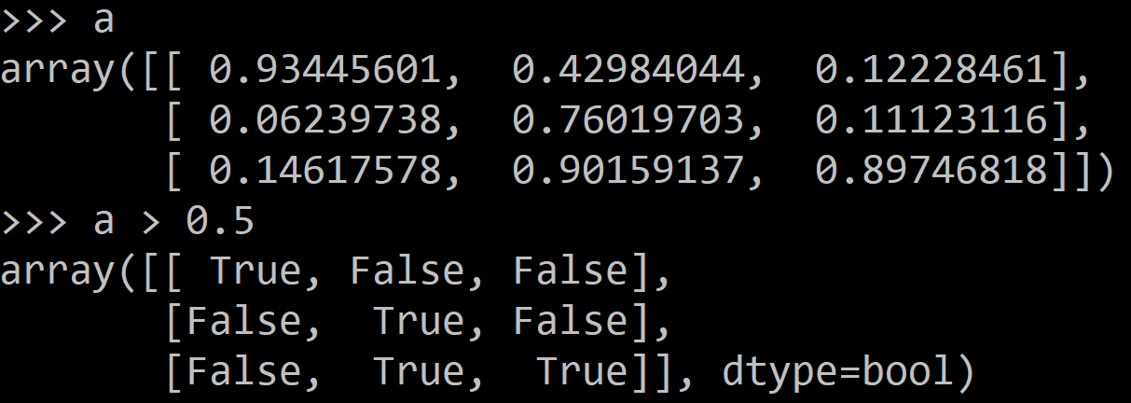
Numpy Mathematical operators
Logical operator return a bool array

Slide 26
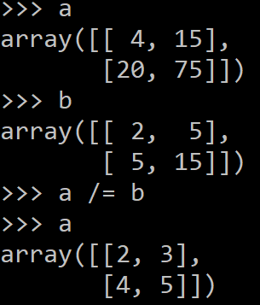
Mathematical operators
In place operations modify the array

Slide 27
Numpy Math: upcasting
Just as in Python and Java, the result of a math operator is cast to the more general or precise datatype.
uint64 + uint16 => uint64
float32 / int32 => float32

Slide 28
Numpy Math: universal functions
Also called ufuncs
Element-wise
Examples:
np.exp
np.sqrt
np.sin
np.cos
np.isnan

Slide 29
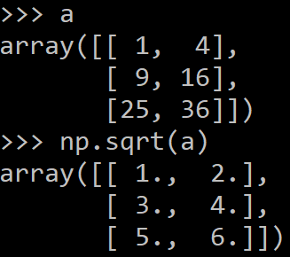
Math, universal functions
Also called ufuncs
Element-wise
Examples:
np.exp
np.sqrt
np.sin
np.cos
np.isnan

Slide 30
Numpy Indexing (see week 2 lecture)
x[0,-1] # first row, last column
x[0,:] # first row (many entries)
x[:,0] # first column (many entries)
Notes:
Zero-indexing
Multi-dimensional indices are comma-separated (i.e., a tuple)

Slide 31
Numpy Slicing (see week 2 lecture)
a = list(range(10))
a[:3] # indices 0, 1, 2
a[-3:] # indices 7, 8, 9
a[3:8:2] # indices 3, 5, 7
a[4:1:-1] # indices 4, 3, 2 (this one is tricky)

Slide 32
Numpy Axes !
a.sum() # sum all entries
a.sum(axis=0) # sum over rows
a.sum(axis=1) # sum over columns
a.sum(axis=1, keepdims=True)
NB: Use the axis parameter to control which axis NumPy operates on

Slide 33
Numpy Broadcasting !
a = a + 1 # add one to every element
When operating on multiple arrays, broadcasting rules are used.
Each dimension must match, from right-to-left
Dimensions of size 1 will broadcast (as if the value was repeated).
Otherwise, the dimension must have the same shape.
Extra dimensions of size 1 are added to the left as needed.

Slide 34
Numpy Broadcasting example
Suppose we want to add a color value to an image
a.shape is 100, 200, 3
b.shape is 3
a + b will pad b with two extra dimensions so it has an effective shape of 1 x 1 x 3.
So, the addition will broadcast over the first and second dimensions.

Slide 35
Numpy Broadcasting failures
If a.shape is 100, 200, 3 but b.shape is 4 then a + b will fail. The trailing dimensions must have the same shape (or be 1)

Slide 36
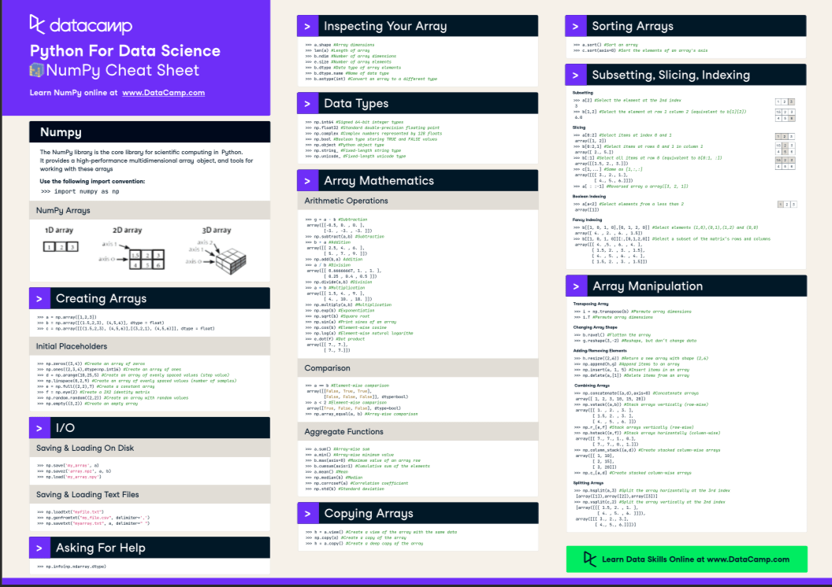

Slide 37

Pandas: “import pandas as np”
Pandas:
adds data structures and tools designed to work with table-like data (similar to Series and Data Frames in R)
provides tools for data manipulation: reshaping, merging, sorting, slicing, aggregation etc.
allows handling missing data (see more details in week 4 lecture)
Link: http://pandas.pydata.org/

Slide 38
Reading data using pandas
:
#Example: Read csv file: salaries of Professors:
df = pd.read_csv("C:/Users/User/OneDrive/Desktop/DATAforML/Salaries.csv“,sep=‘,’)
Note: The above command has many optional arguments to fine-tune the data import process. See here (https://pandas.pydata.org/docs/reference/api/pandas.read_csv.html)
There is a number of pandas commands to read other data formats:
pd.read_excel('myfile.xlsx',sheet_name='Sheet1', index_col=None, na_values=['NA'])
pd.read_stata('myfile.dta')
pd.read_sas('myfile.sas7bdat')
pd.read_hdf('myfile.h5','df')

Slide 39
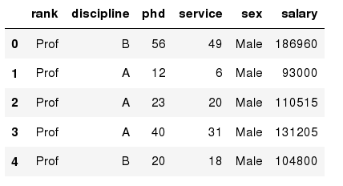
Exploring data frames in Pandas
#List first 5 records
df.head()
Out[3]:

Slide 40
Hands-on exercises
Try to read the first 10, 20, 50 records;
Can you guess how to view the last few records; Hint: ..tail

Slide 41
Pandas: Data Frame data types
In [4]:
#Check a particular column type
df['salary'].dtype
Out[4]: dtype('int64')
In [5]:
#Check types for all the columns
df.dtypes
Out[4]:
object
object
int64
int64
object
int64
rank
discipline
phd
service
sex
salary
dtype: object

Slide 42
Pandas: Data Frames attributes
Python objects have attributes and methods.
df.attribute | description
dtypes | list the types of the columns
columns | list the column names
axes | list the row labels and column names
ndim | number of dimensions
size | number of elements
shape | return a tuple representing the dimensionality
values | numpy representation of the data

Slide 43
Hands-on exercises with Salaries dataset
Find how many records this data frame has;
How many elements are there?
What are the column names?
What types of columns we have in this data frame?

Slide 44
Data Frames methods
Unlike attributes, python methods have parenthesis.
All attributes and methods can be listed with a dir() function: dir(df)
df.method() | description
head( [n] ), tail( [n] ) | first/last n rows
describe() | generate descriptive statistics (for numeric columns only)
max(), min() | return max/min values for all numeric columns
mean(), median() | return mean/median values for all numeric columns
std() | standard deviation
sample([n]) | returns a random sample of the data frame
dropna() | drop all the records with missing values

Slide 45
Hands-on exercises with Salaries dataset
Give the summary for the numeric columns in the dataset
Calculate standard deviation for all numeric columns;
What are the mean values of the first 50 records in the dataset?
Hint: use head() method to subset the first 50 records and then calculate the mean

Slide 46
Pandas: Selecting a column in a Data Frame
Method 1: Subset the data frame using column name:
df['sex']
Method 2: Use the column name as an attribute:
df.sex
Note: there is an attribute rank for pandas data frames, so to select a column with a name "rank" we should use method 1.

Slide 47
Hands-on exercises with Salaries dataset
Calculate the basic statistics for the salary column;
Find how many values in the salary column (use count method);
Calculate the average salary;

Slide 48
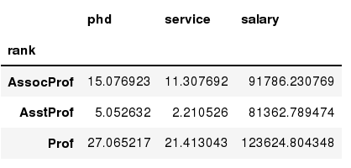
Pandas: Data Frames groupby method
Using "group by" method we can:
Split the data into groups based on some criteria
Calculate statistics (or apply a function) to each group
In [ ]:
#Group data using rank
df_rank = df.groupby(['rank'])
In [ ]:
#Calculate mean value for each numeric column per each group
df_rank.mean()

Slide 49
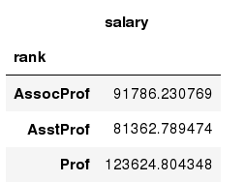
Pandas: Data Frames groupby method
Once groupby object is create we can calculate various statistics for each group:
In [ ]:
#Calculate mean salary for each professor rank:
df.groupby('rank')[['salary']].mean()
Note: If single brackets are used to specify the column (e.g. salary), then the output is Pandas Series object. When double brackets are used the output is a Data Frame

Slide 50
Pandas: Data Frames groupby method
groupby performance notes:
- no grouping/splitting occurs until it's needed. Creating the groupby object only verifies that you have passed a valid mapping
- by default the group keys are sorted during the groupby operation. You may want to pass sort=False for potential speedup:
In [ ]:
#Calculate mean salary for each professor rank:
df.groupby(['rank'], sort=False)[['salary']].mean()

Slide 51
Pandas Data Frame: filtering
To subset the data we can apply Boolean indexing. This indexing is commonly known as a filter. For example if we want to subset the rows in which the salary value is greater than $120K:
In [ ]:
#Calculate mean salary for each professor rank:
df_sub = df[ df['salary'] > 120000 ]
Any Boolean operator can be used to subset the data:
> greater; >= greater or equal;
< less; <= less or equal;
== equal; != not equal;
In [ ]:
#Select only those rows that contain female professors:
df_f = df[ df['sex'] == 'Female' ]

Slide 52
Pandas Data Frames: Slicing
There are a number of ways to subset the Data Frame:
one or more columns
one or more rows
a subset of rows and columns
Rows and columns can be selected by their position or label

Slide 53
Pandas Data Frames: Slicing
When selecting one column, it is possible to use single set of brackets, but the resulting object will be a Series (not a DataFrame):
In [ ]:
#Select column salary:
df['salary']
When we need to select more than one column and/or make the output to be a DataFrame, we should use double brackets:
In [ ]:
#Select column salary:
df[['rank','salary']]

Slide 54
Pandas Data Frames: Selecting rows
If we need to select a range of rows, we can specify the range using ":"
In [ ]:
#Select rows by their position:
df[10:20]
Notice that the first row has a position 0, and the last value in the range is omitted:
/!\ So for 0:10 range the first 10 rows are returned with the positions starting with 0 and ending with 9

Slide 55
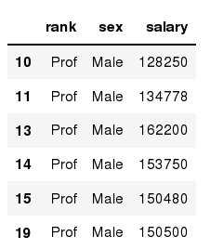
Pandas Data Frames: method loc
If we need to select a range of rows, using their labels we can use method loc:
In [ ]:
#Select rows by their labels:
df_sub.loc[10:20,['rank','sex','salary']]
Out[ ]:

Slide 56
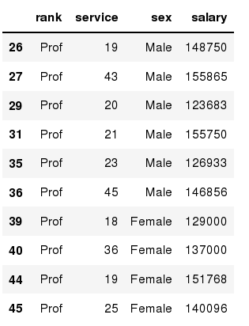
Pandas Data Frames: method iloc
If we need to select a range of rows and/or columns, using their positions we can use method iloc:
In [ ]:
#Select rows by their labels:
df_sub.iloc[10:20,[0, 3, 4, 5]]
Out[ ]:

Slide 57
Pandas Data Frames: method iloc (summary)
df.iloc[0] # First row of a data frame
df.iloc[i] #(i+1)th row
df.iloc[-1] # Last row
df.iloc[:, 0] # First column
df.iloc[:, -1] # Last column
df.iloc[0:7] #First 7 rows
df.iloc[:, 0:2] #First 2 columns
df.iloc[1:3, 0:2] #Second through third rows and first 2 columns
df.iloc[[0,5], [1,3]] #1st and 6th rows and 2nd and 4th columns

Slide 58
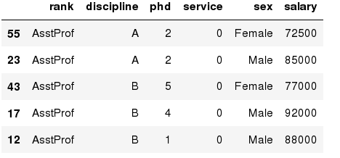
Pandas Data Frames: Sorting
We can sort the data by a value in the column. By default the sorting will occur in ascending order and a new data frame is returned.
In [ ]:
# Create a new data frame from the original sorted by the column Salary
df_sorted = df.sort_values( by ='service')
df_sorted.head()
Out[ ]:

Slide 59
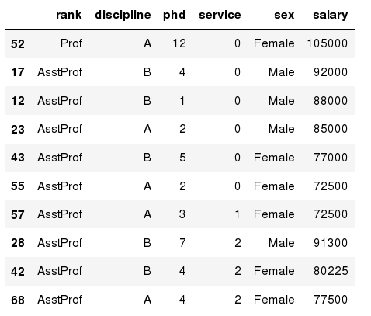
Pandas Data Frames: Sorting
We can sort the data using 2 or more columns:
In [ ]:
df_sorted = df.sort_values( by =['service', 'salary'], ascending = [True, False])
df_sorted.head(10)
Out[ ]:

Slide 60
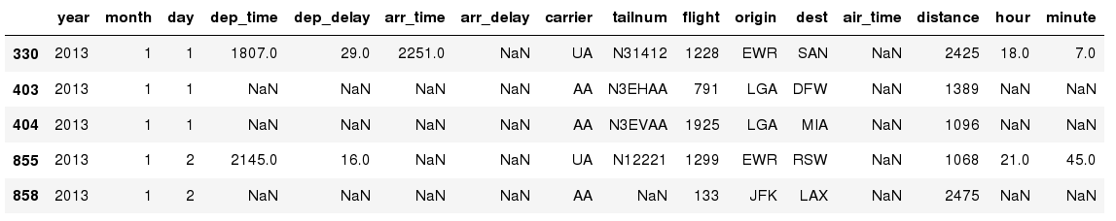
Missing Values
Missing values are marked as NaN
# Read a dataset with missing values: flight dataset
flights = pd.read_csv(" C:/Users/User/OneDrive/Desktop/DATAforML /flights.csv“,sep=“,”)
In [ ]:
# Select the rows that have at least one missing value
flights[flights.isnull().any(axis=1)].head()
Out[ ]:

Slide 61
Missing Values
There are a number of methods to deal with missing values in the data frame:
df.method() | description
dropna() | Drop missing observations
dropna(how='all') | Drop observations where all cells is NA
dropna(axis=1, how='all') | Drop column if all the values are missing
dropna(thresh = 5) | Drop rows that contain less than 5 non-missing values
fillna(0) | Replace missing values with zeros
isnull() | returns True if the value is missing
notnull() | Returns True for non-missing values

Slide 62
Missing Values
When summing the data, missing values will be treated as zero
If all values are missing, the sum will be equal to NaN
cumsum() and cumprod() methods ignore missing values but preserve them in the resulting arrays
Missing values in GroupBy method are excluded
Many descriptive statistics methods have skipna option to control if missing data should be excluded . This value is set to True by default (unlike R)

Slide 63
Aggregation Functions in Pandas
Aggregation - computing a summary statistic about each group, i.e.
compute group sums or means
compute group sizes/counts
Common aggregation functions:
min, max
count, sum, prod
mean, median, mode, mad
std, var

Slide 64
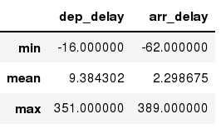
Aggregation Functions in Pandas
agg() method are useful when multiple statistics are computed per column:
flights[['dep_delay','arr_delay']].agg(['min','mean','max'])
Out[ ]:

Slide 65
Basic Descriptive Statistics
df.method() | description
describe | Basic statistics (count, mean, std, min, quantiles, max)
min, max | Minimum and maximum values
mean, median, mode | Arithmetic average, median and mode
var, std | Variance and standard deviation
sem | Standard error of mean
skew | Sample skewness
kurt | kurtosis

Slide 66
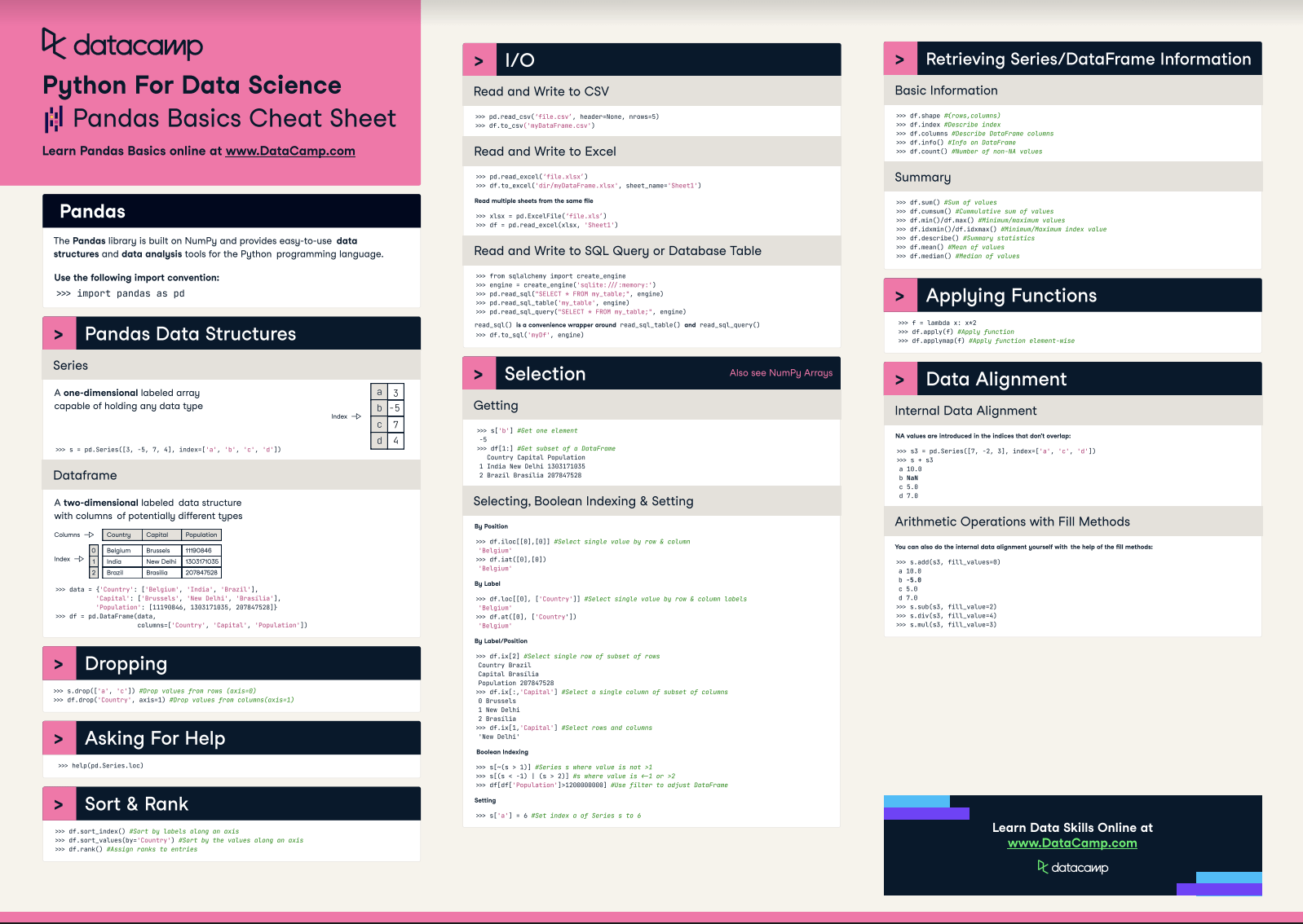

Slide 67
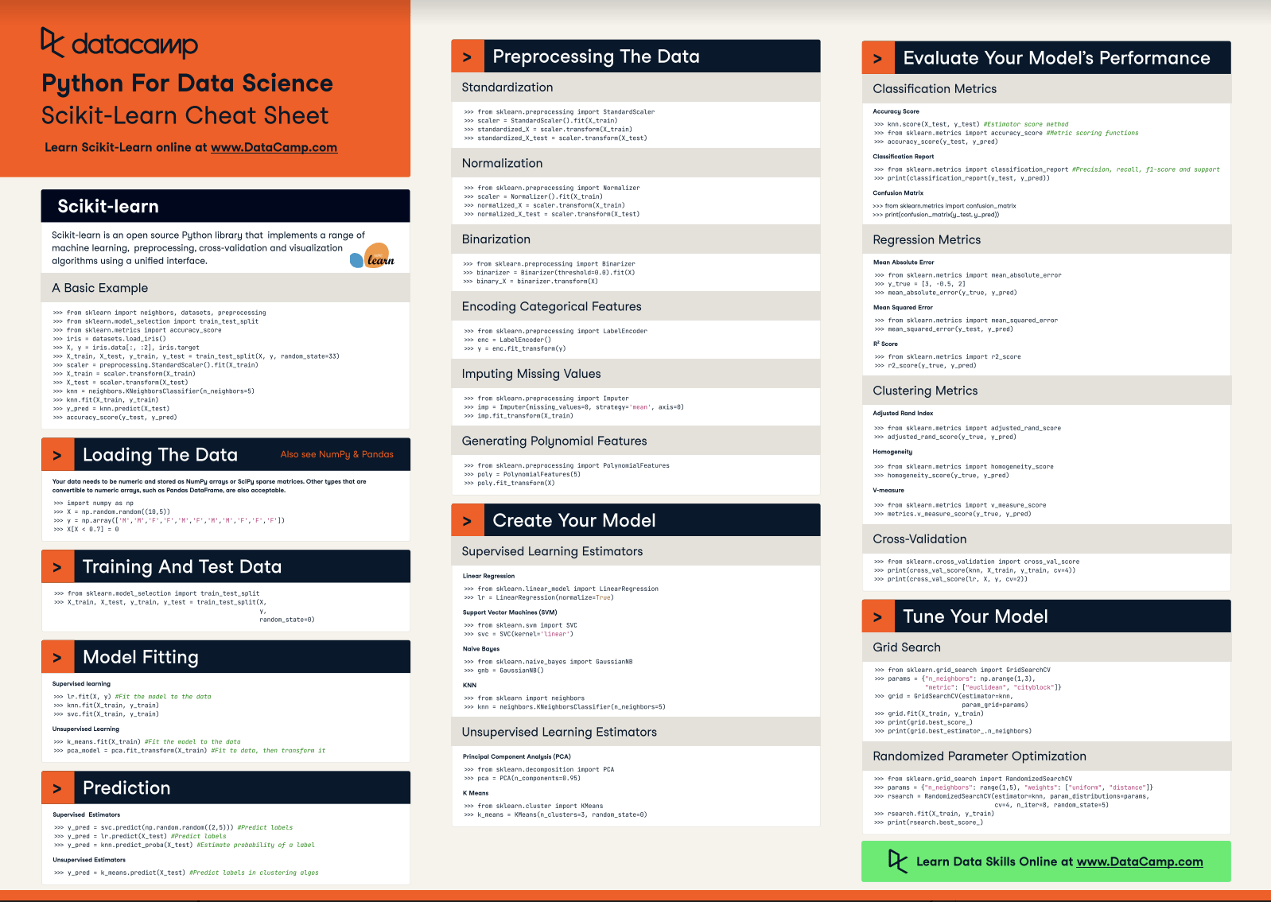
Scikit-Learn

Slide 68
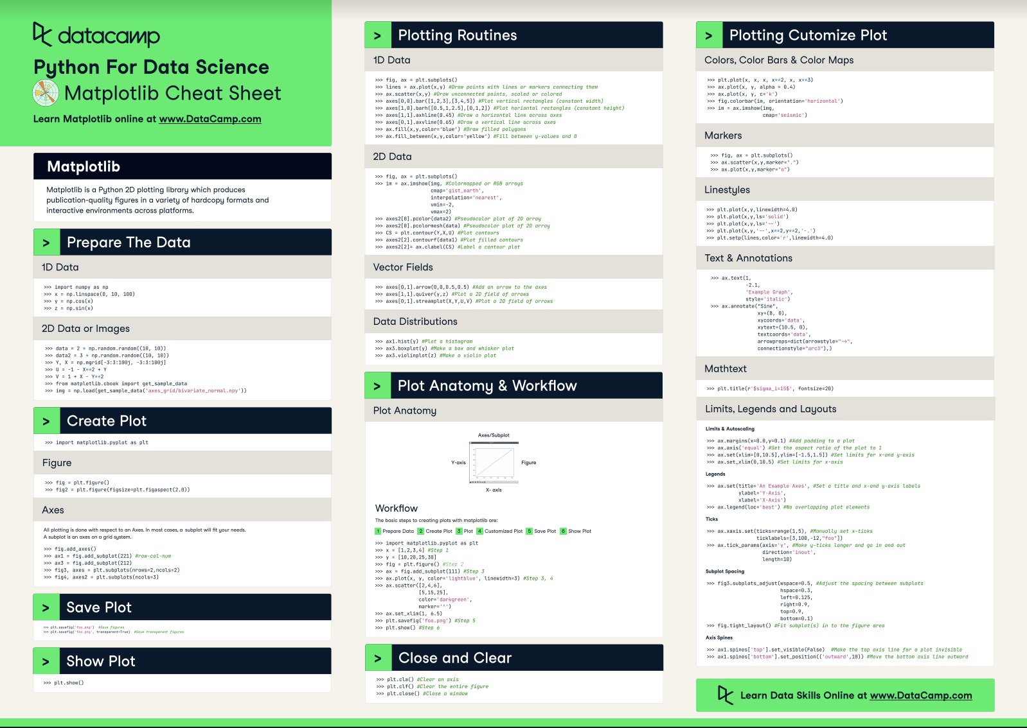
Matplotlib

Slide 69
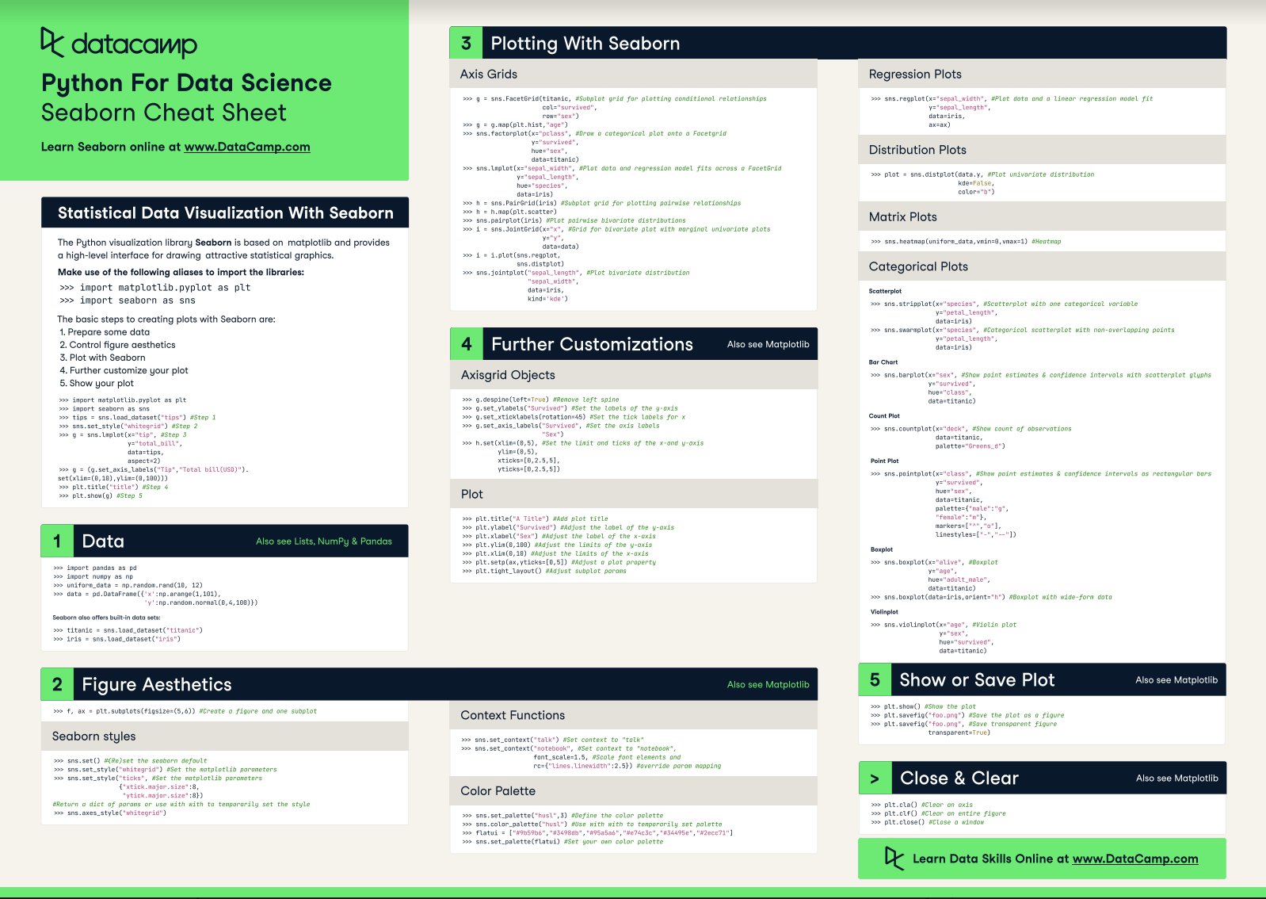

Slide 70
Graphics to explore the data
Seaborn package is built on matplotlib but provides high level interface for drawing attractive statistical graphics, similar to ggplot2 library in R. It specifically targets statistical data visualization
To show graphs within Python notebook include inline directive:
In [ ]:
%matplotlib inline

Slide 71
Graphics
 | description
distplot | histogram
barplot | estimate of central tendency for a numeric variable
violinplot | similar to boxplot, also shows the probability density of the data
jointplot | Scatterplot
regplot | Regression plot
pairplot | Pairplot
boxplot | boxplot
swarmplot | categorical scatterplot
factorplot | General categorical plot

Slide 72
Python Statistical Analysis
statsmodel and scikit-learn - both have a number of function for statistical analysis
The first one is mostly used for regular analysis using R style formulas, while scikit-learn is more tailored for Machine Learning.
statsmodels:
linear regressions, logistic regression, ARIMA, VAR, GLM, Nonparametrics..
ANOVA tests, Distributions, PCA, Factor Analysis, MANOVA,
hypothesis testings
many more ...
scikit-learn:
Kmeans, KNN, Neural Network
support vector machines
random forests
many more ...
See examples in the Tutorial Notebook below

